Slide 1
CONVERSION
CALCULATOR

Slide 2
TITLE : CODE CONVERSION
NAME : ANISH RAM A
REG NO : 727822TUCS013
DEPARTMENT : CSE
SECTION : ‘ A ’
INDUSTRY MENTOR : Mr.R.MANOPALANIRAJA
PROJECT GUIDE : Ms.P.KALPANA

Slide 3
The concept of transforming one number from one unit to other.
It is often necessary to convert between different units or representations in order to compare, analyse, or solve problems involving mathematical quantities.
Conversion allows for greater flexibility and precision in mathematical computations and is therefore an essential tool in many mathematical fields, including physics, engineering, finance, and statistics. By converting between units, we can express quantities in a more standardized, universal way, which can be useful for making calculations, interpreting data, or communicating results to others.
Abstract

Slide 4

#Login Page
Place where users can enter their username and password to enter into the conversion pages.

Slide 5

#Sign Up
Users without account can use this page to create an account

Slide 6
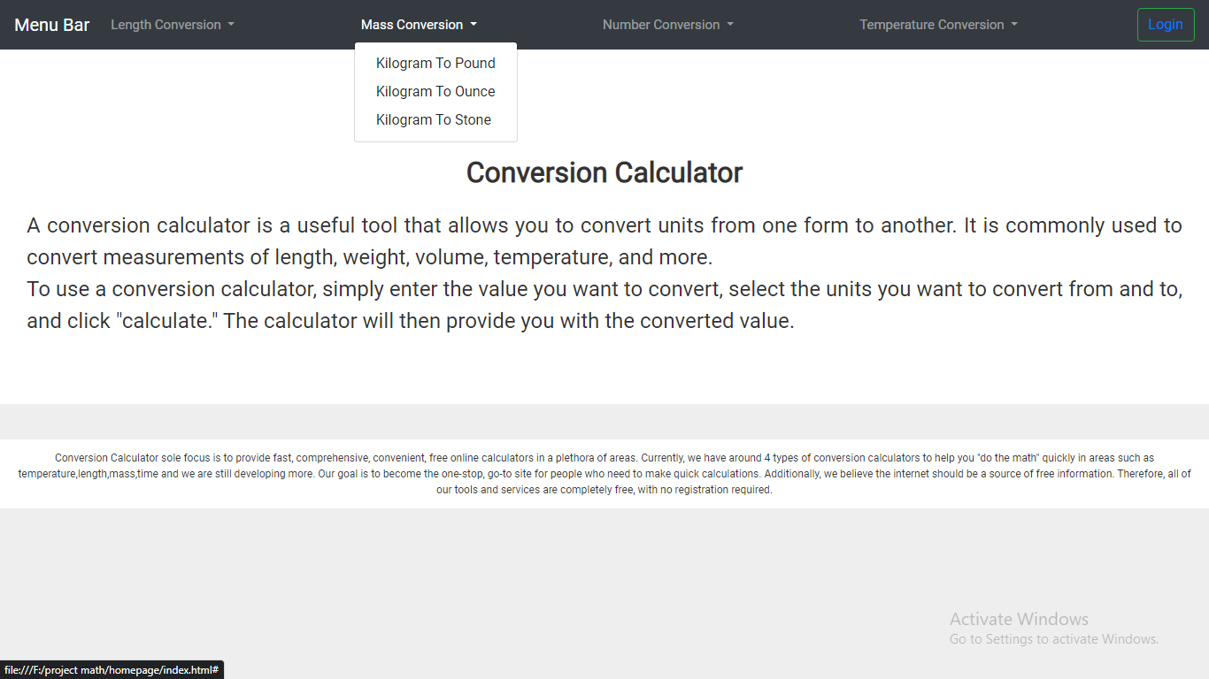
#Home Page
Place where users can know about our page and can select converting units available based on their requirements

Slide 7
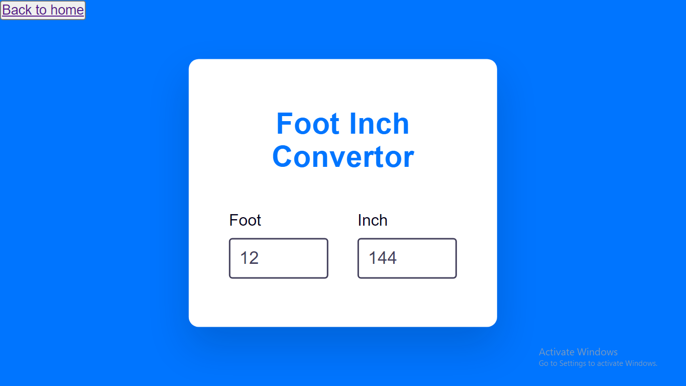
#Length Conversion
Users can select one from various length uints
Kilometer to Mile
Meter to Yard
Foot to Inch

Slide 8
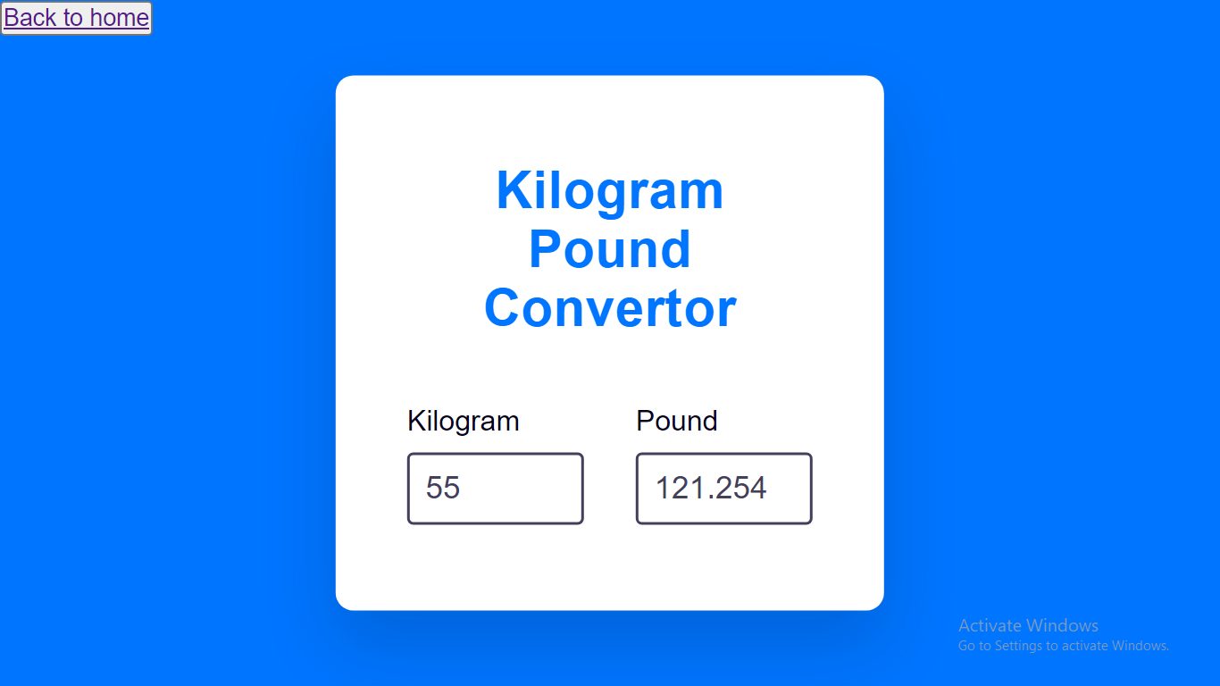
#Mass Conversion
Users can select one from various mass uints
Kilogram to Pound
Kilogram to Ounce
Kilogram to Stone

Slide 9
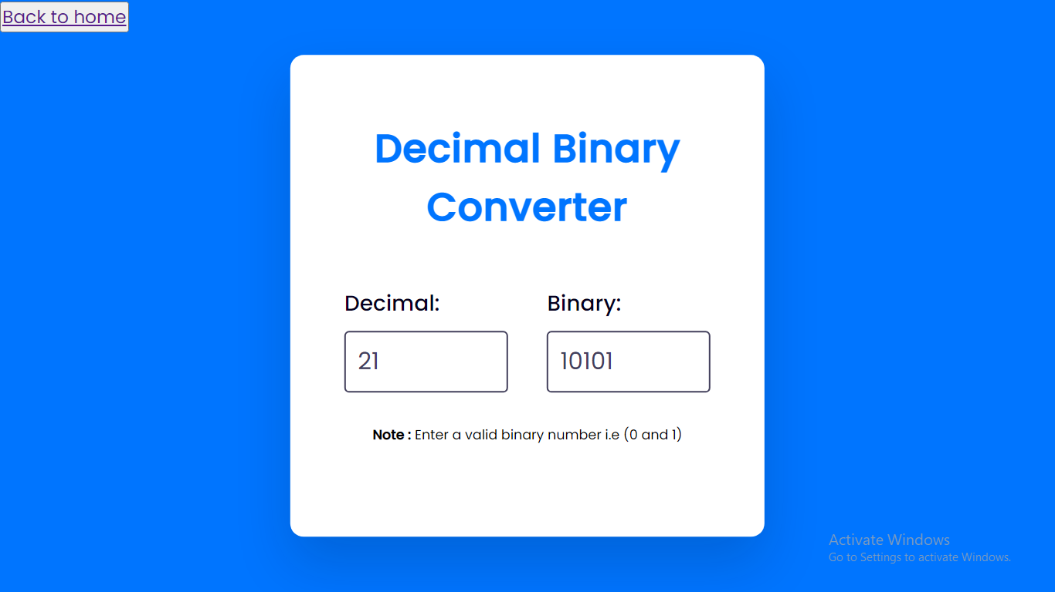
#Number Conversion
Users can select one from various number uints
Decimal to Binary
Decimal to Octal
Decimal to Hexadecimal

Slide 10
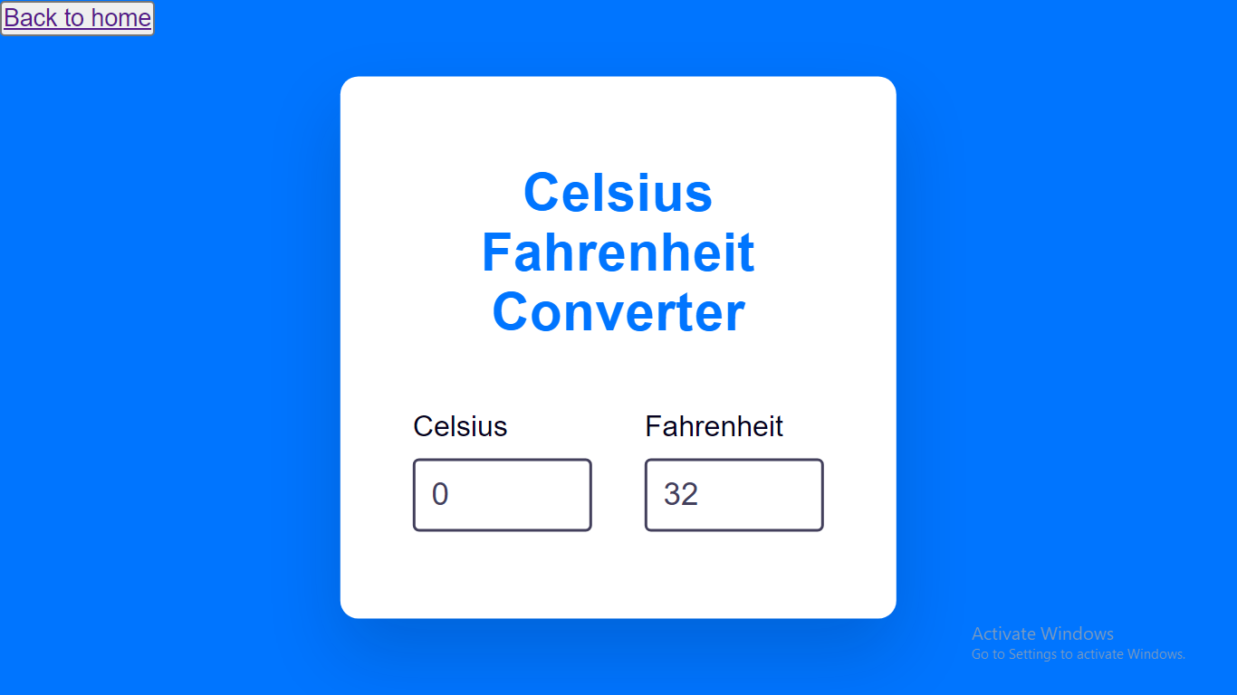
#Temperature Conversion
Users can select one from various temperature uints
Celcius to Fahrenheit
Celcius to Kelvin
Fahrenheit to Kelvin

Slide 11
Future Scope
Extend the available units for conversion.
Further will add calculator that will find area , volume , perimeter of selected shapes
Further financial calulators such as tax calculator , gst calculator will also be added to make calculations easy
Continuously will keep on adding items that will make calculations easier and faster

Slide 12
M
A
T
H
Miracle of Nature
Art of Arithmetic
Tool of Knowledge
Habit of Problem Solving

Slide 13
The completion of the Conversion Calculator website project is an important milestone. This provided our users with a fast and reliable way to convert a number from one unit to another. I have been able to make the website userfriendly . I have also been able to provide our customers with a wide selection of components to choose from, making it easier for them convert numbers.
Conclusion

Slide 14
Mathematics is the queen of science, and arithmetic is the queen of Mathematics

Slide 15
Thank you!

